Slide 1

Unmasking the Sneaky Side of Deep Neural Networks: Adventures in Securing Edge Devices!
By Reema George Dass

Slide 2

Threat Model
Attackers Goal: Model Extraction / Stealing.
Attackers Knowledge: Functionality of the application.
Attackers Capabilities: Access to the edge deployed model code.

Slide 3

Problem statement!!
Safeguarding DNN Deployments on the Edge

Slide 4

Real World Scenario:
Research: Mind YourWeight(s): A Large-scale Study on Insufficient Machine Learning Model Protection in Mobile Apps
Setup:
Total Apps: 1,468 Ml apps
Unprotected: 41%
Protected yet stolen(Encrypted): 66%
Frameworks Analysed:
TensorFlow, Tflite, Caffee, SenseTime, Baidu, Face++.
File Formats Analysed:
.pb, .tflite, .model, .pkl, .thrift.
Attack model:
Model Xray
Model Extractor

Slide 5
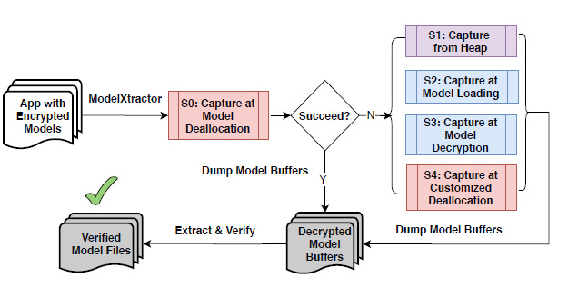
MODEL EXTRACTOR
SENSE TIME
Specific-example: Banking Apps
Use-case: More than 100 apps using on-device ML models for banking and loan services via face recognition.
Attack: When the models are leaked, attackers can easily fake identities of other applicants, and apply for loans on their behalf.

Slide 6

Approaches to secure our edge deployed models:
Obfuscation
Encryption
Compilation
Execution on TEE

Slide 7
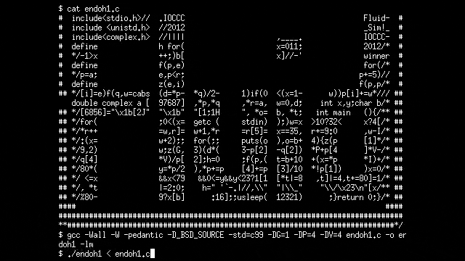
Obfuscation
What?
Obfuscation means to make something difficult to understand.
Programming code is often obfuscated to protect intellectual property.
Obfuscation can be achieved by:
Renaming
Parameter encapsulation
Neural structure obfuscation
Shortcut injection
Extra layer injection

Slide 8
Obfuscation
Pro‘s
Easy to implement
Better Privacy Preservation
Con‘s
Not Absolute Security
Reversible
Memory constraints
Reference Papers: Obfuscation

Slide 9

Encryption
What?
Encrypting edge-deployed models involves adding a layer of security to protect the model and its associated data when the model is deployed on edge devices.
Encryption can be achieved by:
Homomorphic Encryption
TF-encryption

Slide 10
Encryption
Pro‘s
Intellectual Property Protection
Privacy Preservation
Model Security
Con‘s
Computational Overhead
Complexity / Execution time
Latency and Real-time Processing
Performance vs. Security Trade-off
Not open souce
Reference Papers: Encryption

Slide 11
Compilation
What?
Edge-deployed model compiling refers to the process of preparing and optimizing a deep learning model in suitable format for execution on edge devices.
Compilation can be achieved by:
Converting the code in irreversible Format
Concept of Decompilation
What?
Reverse Engineering the compiled code to steal the model.

Slide 12
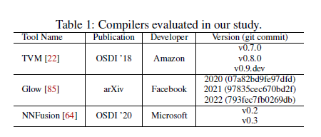
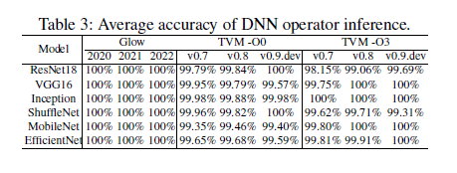
DeCompilation
Research: Decompiling x86 Deep Neural Network Executables
BTD recovers full DNN models from binary executables, including operator types, network topology, dimensions, and parameters.

Slide 13
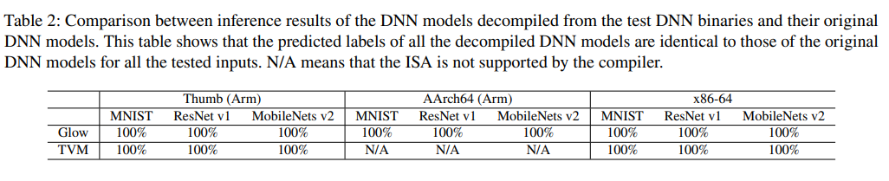
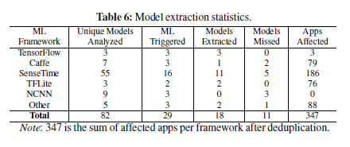
DeCompilation
Research: DnD: A Cross-Architecture Deep Neural Network Decompiler
Research: Mind Your Weight(s): A Large-scale Study on Insufficient Machine Learning Model Protection in Mobile Apps

Slide 14
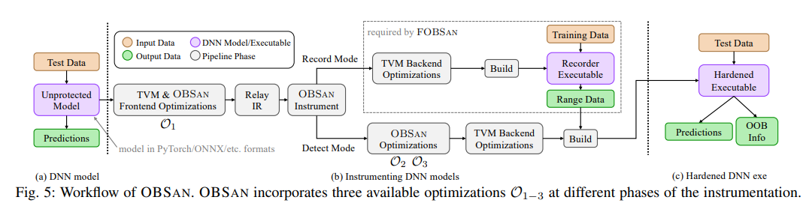
OBSAN: An Out-Of-Bound Sanitizer to Harden DNN Executables
Alternate solution : OBSAN: An Out-Of-Bound Sanitizer to Harden DNN Executables
Reference Papers: Decompilation, Compilation_Related

Slide 15
Compilation
Pro‘s
Privacy Preservation
Model Security
Easier to implement
Con‘s
No specific research done
Decompilable
Reference Papers: Encryption

Slide 16

Trusted Execution Environment
What?
A trusted execution environment (TEE) is a secure area of a main processor. It helps code and data loaded inside it to be protected with respect to confidentiality and integrity.
For example:
ARM Trust Zone
Intel SGX

Slide 17
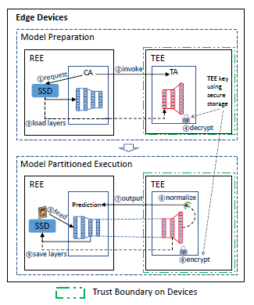
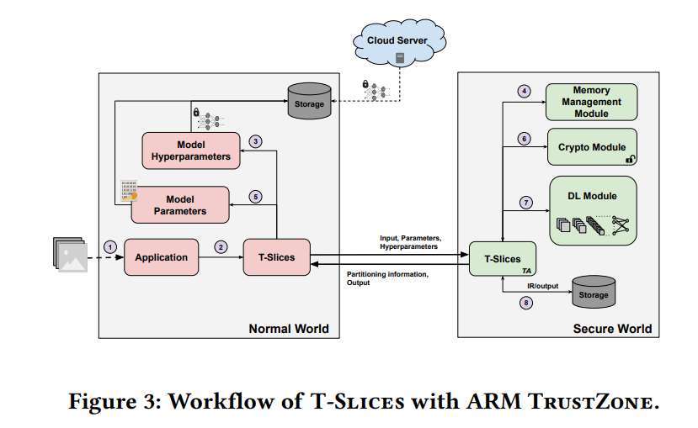
How does it work?
Approach 1
Approach 2

Slide 18
Trusted Execution Environment!!!
Pro‘s
Secured Execution
Intellectual Property Protection
No model code modifications
No accuracy compromises
Con‘s
Hardware Requirements
Hardware knowledge
Memory Constraints
Different approaches have different limitations
Reference Papers: TEE

Slide 19
Thanks!

Slide 20
Obfuscation:
Model Obfuscation for Securing Deployed Neural Networks
ModelObfuscator: Obfuscating Model Information to ProtectDeployed ML-based Systems
DeepObfuscation: Securing the Structure of Convolutional Neural Networks via Knowledge Distillation
A Taxonomy of Obfuscating Transformations
Encryption:
Survey of Attacks and Defenses on Edge-Deployed Neural Networks
Mind Your Weight(s): A Large-scale Study on Insufficient Machine Learning Model Protection in Mobile Apps
Privacy-preserving searchable encryption in the intelligent edge computing
Novel Defense Schemes for Artificial Intelligence Deployed in Edge Computing Environment
.

Slide 21
Compilation_Related:
OBSan: An Out-Of-Bound Sanitizer to Harden DNN Executables
Decompilation:
DnD: A Cross-Architecture Deep Neural Network Decompiler
Decompiling x86 Deep Neural Network Executables
TEE:
Confidential Execution of Deep Learning Inference at the Untrusted Edge with ARM TrustZone
Slalom: Fast, Verifiable and Private Execution of Neural Networks in Trusted Hardware
DarkneTZ: Towards Model Privacy at the Edge using Truste Execution Environments
MLCapsule: Guarded Offline Deployment of Machine Learning as a Service
Trusted-DNN: A TrustZone-based Adaptive Isolation Strategy for Deep Neural Networks
eNNclave: Offline Inference with Model Confidentiality
.

